Slide 1
Chat Application
Dr/ Hosny Ahmed Abbas
Dr/ Omar Atef

Slide 2
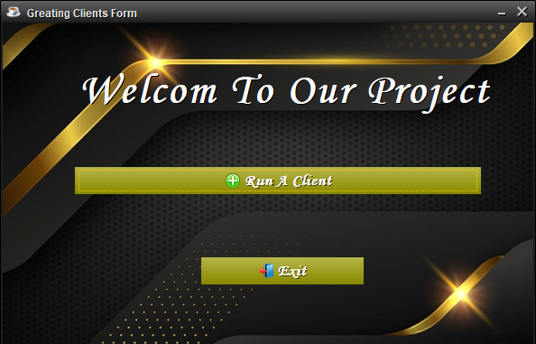
Chat Application with TCP Multi-Threaded Protocol.
In This form you can create a new client with id.
The first button “Run A client”: by pressed it manage you to create serval clients as you want.
The second button “Exit”: close The form and can not add a new client anymore.

Slide 3
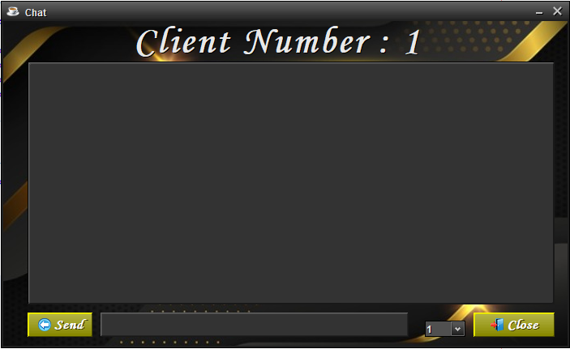
This chat form in the above there is the client id.
In bottom, text field that you can write your message
By the combo box you can select the id of client you want to chat with him.
By a “send” button you send this message to selected client “client id”.
The text field in the middle you can see all the chat that you do with other clients.
The “close” button you close this client form.

Slide 4
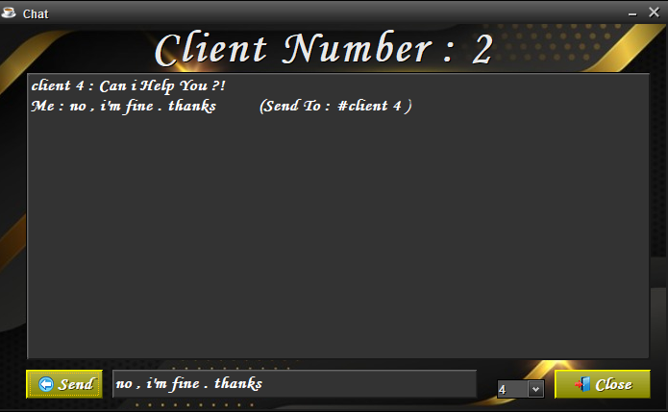
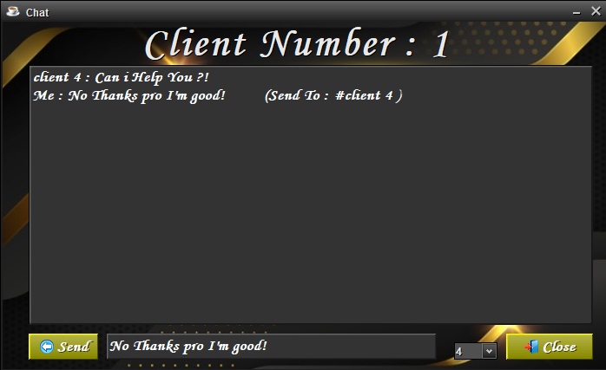
In these slides we show how the clients chat together, we see client 1 send messages to client 4, client 3 send and receive from and to client 4, client 1 send and receive from and to client 2 and 3 and client 2 send to client 1 too.
All these messages are encrypted by RSA algorithm and sent to server as encrypted messages then each client decrypt its received messages by its private key.

Slide 5
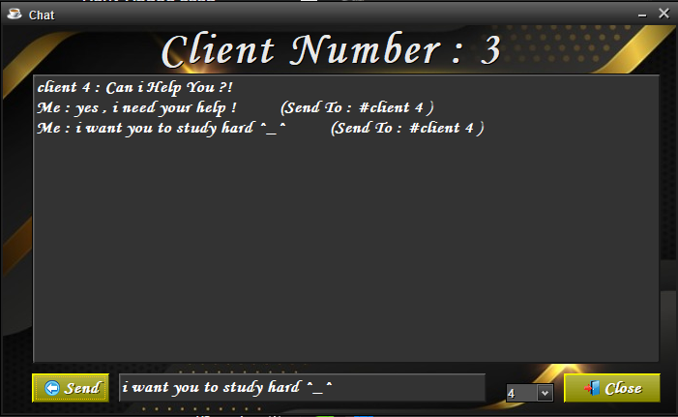
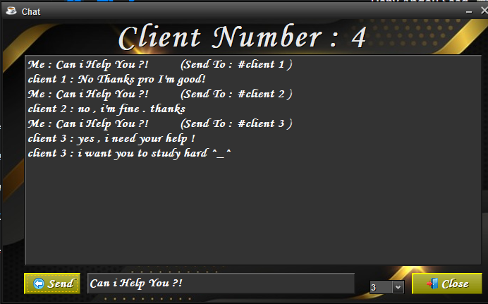

Slide 6
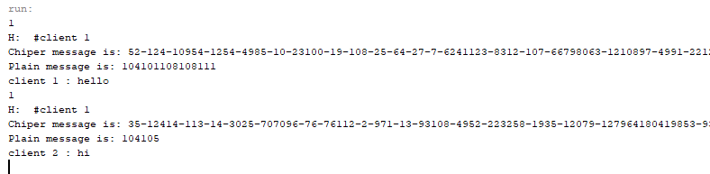
Here we show Encrypt messages as array of bytes and the decrypt messages after they decrypt by the client.

Slide 7
Introduced by:
Hany Abdou Saad
Hazem Taha Basher
Moaz Wahed Ramadan

Slide 8
Let’s Run The Project
RUN

